Slide 1

OBJECT-ORIENTED Programming Concepts in Java
Understanding the Core Principles

Slide 2
Introduction to OOP
What is OOP?
Programming paradigm based on objects
Emphasizes data and methods
Key Benefits:
Modularity
Reusability
Maintainability

Slide 3
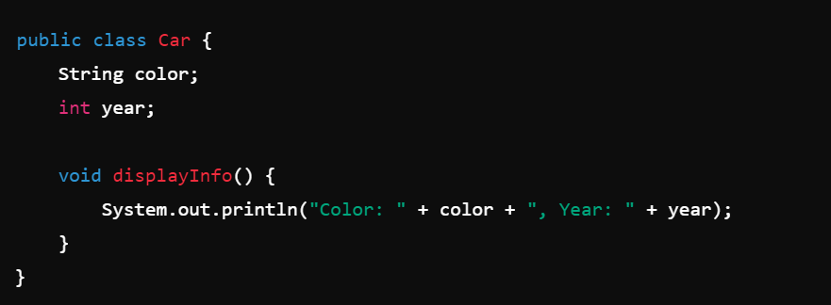
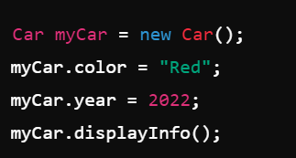
CLASSES AND OBJECTS
Class: Blueprint for creating objects
Object: Instance of a class

Slide 4
POLYMORPHISM
Ability to perform a single action in different forms
Types
Compile-time (Method Overloading): Multiple methods with the same name but different parameters
Runtime (Method Overriding): Subclass method overrides superclass method

Slide 5

ABSTRACTION
Hiding implementation details and showing only the essential features
Abstract Classes: Cannot be instantiated; can contain abstract methods
Interfaces: Provide a way to achieve abstraction; can be implemented by any class

Slide 6

ENCAPSULATION
Wrapping data (fields) and methods into a single unit (class)
1
Controlling access through access modifiers
2

Slide 7
INHERITANCE
Single Inheritance
  A subclass inherits from one and only one superclass.
Multiple Inheritance

